Slide 1
STRUCTURED STREAMING
Session 1: First steps
Juan Carlos López

Slide 2

Agenda
Basics
Streaming DataFrames
Hands-on lab using PySpark 3.3.0
10:00 - 10:20
10:20 - 11:20
11:45 - 13:00

Slide 3

Reminder
Let’s start cloning the repository
and executing “docker-compose up”.
https://github.com/jcarloslr10/structured-streaming

Slide 4
What is Structured Streaming?
“Structured Streaming is a scalable and fault-tolerant stream processing engine built on the Spark SQL engine. You can express your streaming computation the same way you would express a batch computation on static data. The Spark SQL engine will take care of running it incrementally and continuously and updating the final result as streaming data continues to arrive…”

Slide 5
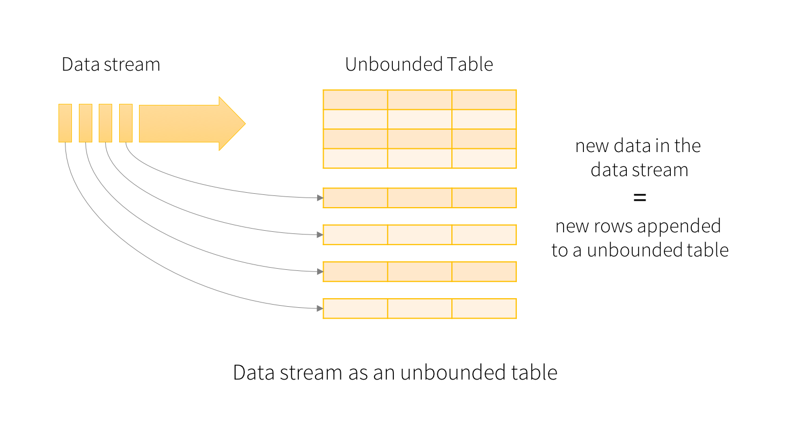
Basics Stream
Treat as an unbounded table
Continuously appended
Incremental query approach

Slide 6
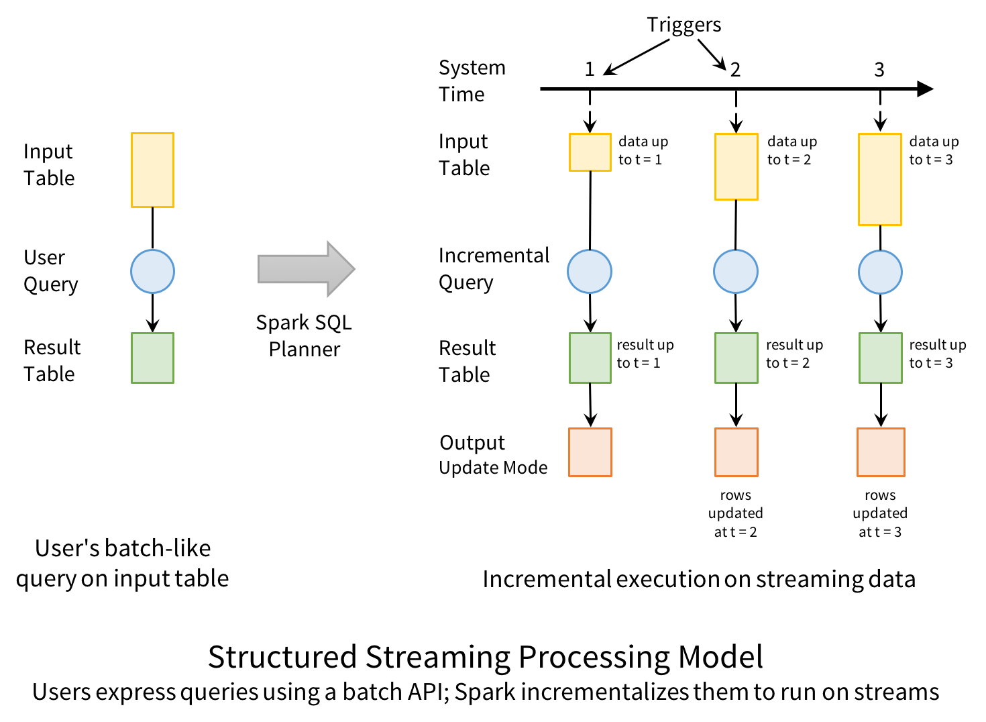
Basics Stream
Input table: new data arriving
Incremental query: filter, aggregation, project…
Result table: compute a final table
Output ¹: write to external sink
¹ Output modes will be covered later
Notes:
hola

Slide 7
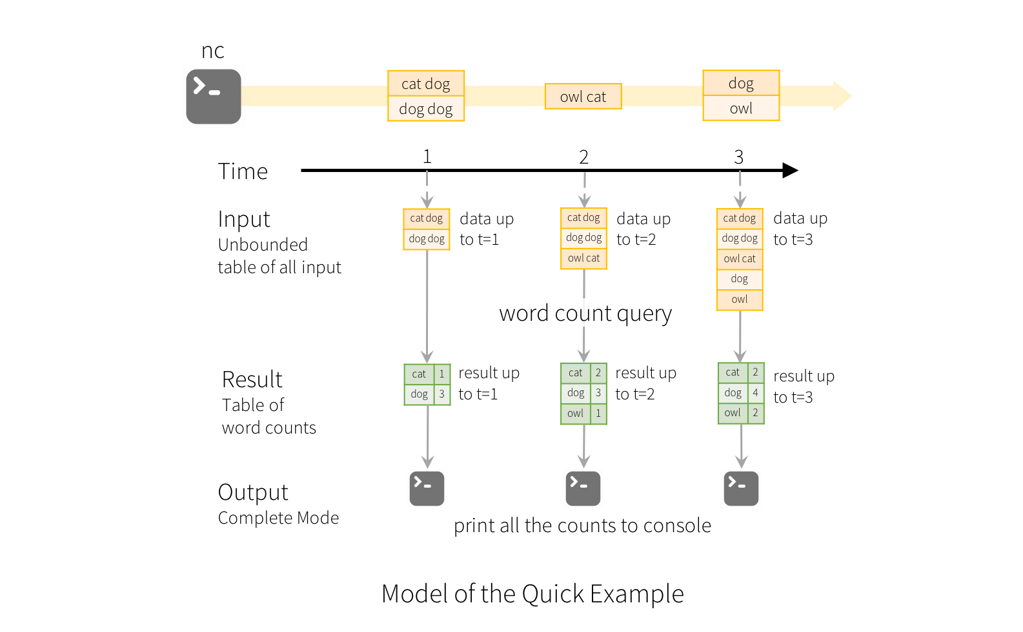
Basics Stream
Input table: new data arriving
Incremental query: filter, aggregation, project…
Result table: compute a final table
Output ¹: write to external sink
¹ Output modes will be covered later

Slide 8
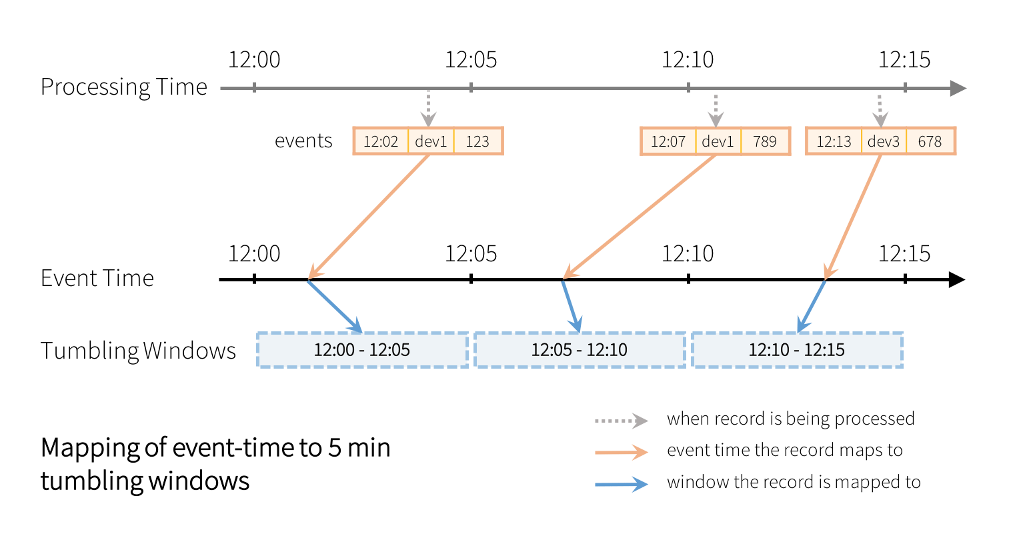
Basics Event-time
Event-time is NOT Processing-time
Event-time: timestamp embedded in the event data
Processing-time: the time when Spark receives the data
Allows window-based aggregations

Slide 9
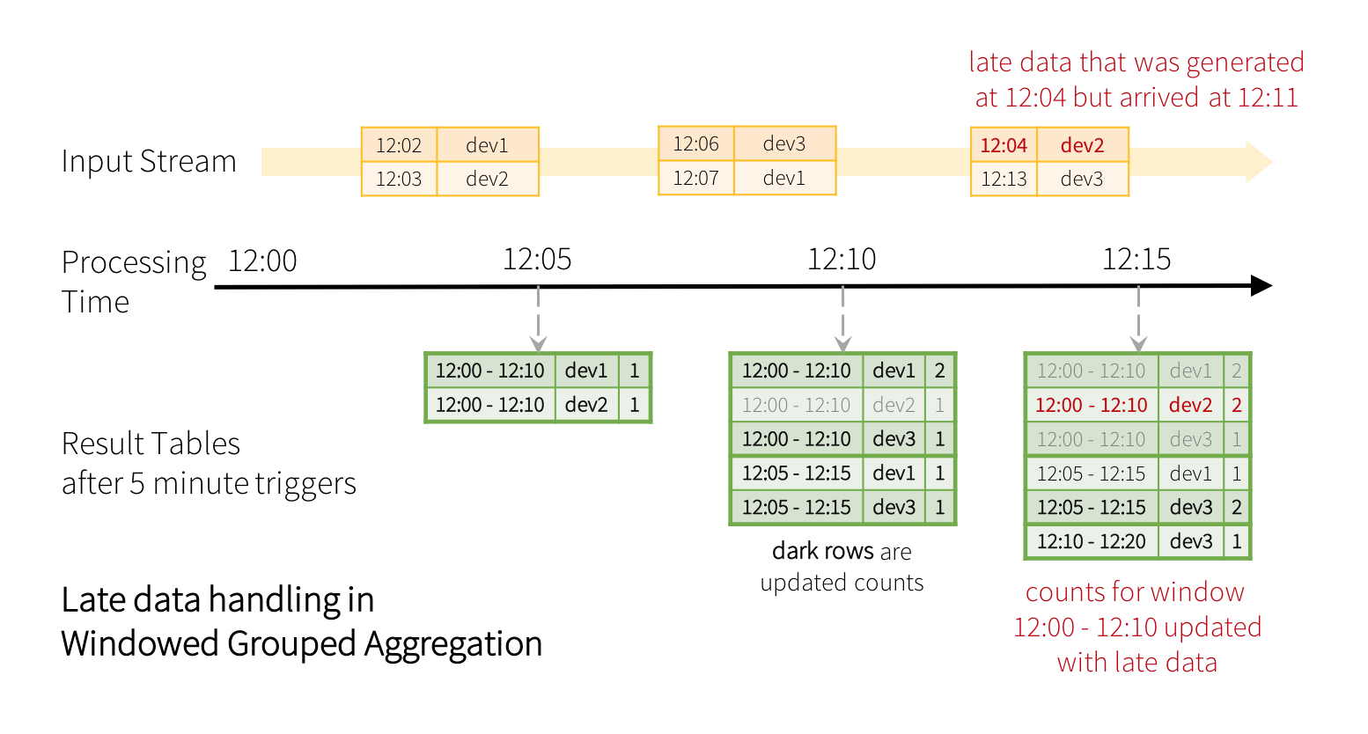
Basics Late data
Window-based aggregations enables watermarking
Watermarking: threshold for handling late data

Slide 10
What is a DataFrame or Dataset?
“DataFrames and Datasets can represent static, bounded data, as well as streaming, unbounded data. Similar to static Datasets/DataFrames, you can use the common entry point SparkSession to create streaming DataFrames/Datasets from streaming sources, and apply the same operations on them as static DataFrames/Datasets…”

Slide 11
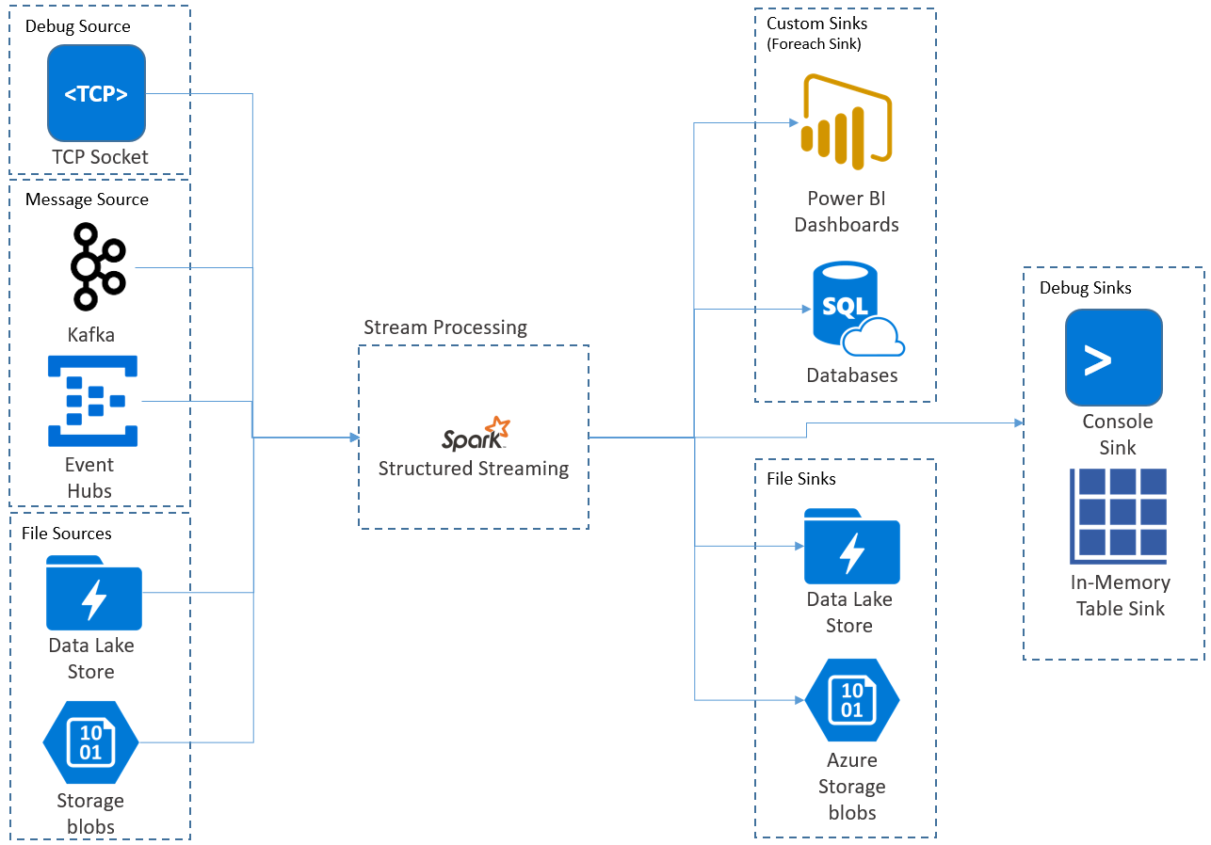
Streaming DataFrames Input sources
File source
Kafka source (or protocol compliant)
Socket source (for testing)
Rate source (for testing)
Rate Per Micro-Batch source (for testing)

Slide 12
Streaming DataFrames Schema enforcement
Spark allows schema inference
Write once a sample of data into destination
Set spark.sql.streaming.schemaInference to true
File-based sources require schema specification by default
Auto-inference requires one extra pass over the data

Slide 13
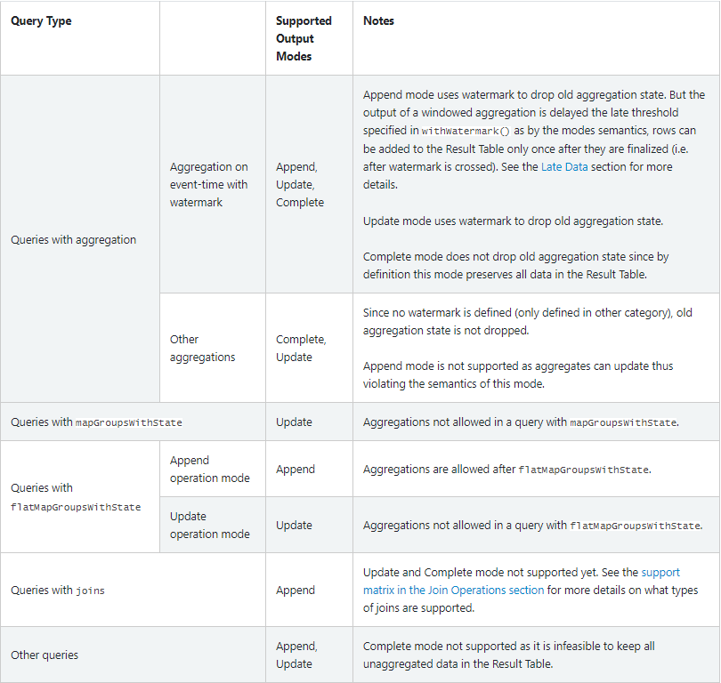
Streaming DataFrames Output modes
Append mode (default)
Complete mode
Update mode

Slide 14
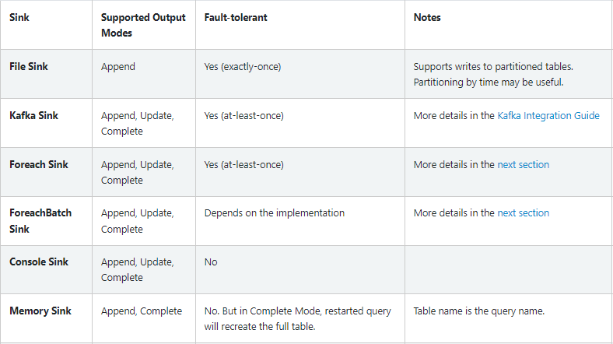
Streaming DataFrames Output sinks
File sink
Kafka sink (or protocol compliant)
Foreach sink
Console sink (for debugging)
Memory sink (for debugging)

Slide 15
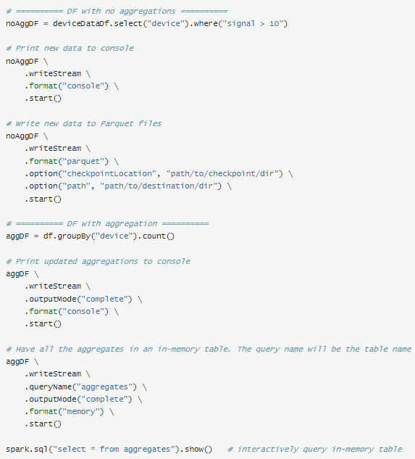
Streaming DataFrames Output sinks
File sink
Kafka sink (or protocol compliant)
Foreach sink
Console sink (for debugging)
Memory sink (for debugging)

Slide 16
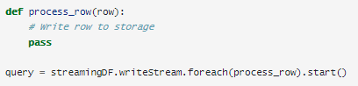
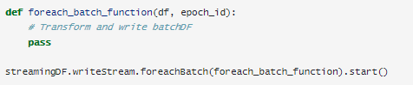
Streaming DataFrames Output sinks
Foreach sink
Types
Foreach (every row)
ForeachBatch (every micro-batch)
Write to multiple locations
Apply additional DataFrame operations

Slide 17
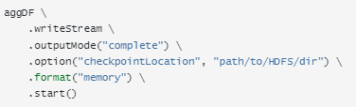
Streaming DataFrames Checkpoints
Track the progress (offsets)
Write-ahead logs
Allows recovering from:
Failures
Intentional shutdown

Slide 18
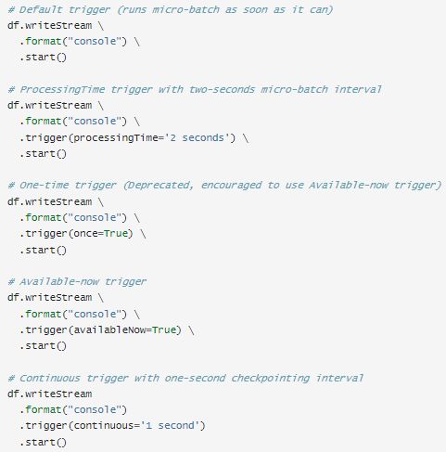
Streaming DataFrames Triggers
Unspecified (default)
As soon as previous micro-batch has completed processing. Latency of ~100 ms at best with exactly-one fault-tolerance guarantees
Fixed interval micro-batches
User specified interval
One-time micro-batch (deprecated)
Execute only one micro-batch to process all and then stop
Available-now micro-batch
As above but in multiple micro-batches
Continuous with fixed checkpoint interval (experimental)
Low latency mode (~1 ms) with at-least-once fault-tolerance guarantees

Slide 19
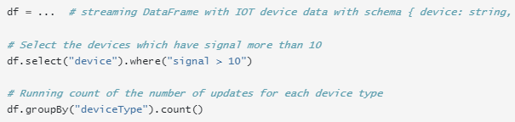
Streaming DataFrames Operations
Supported operations:
Selection
Projection
Aggregation

Slide 20
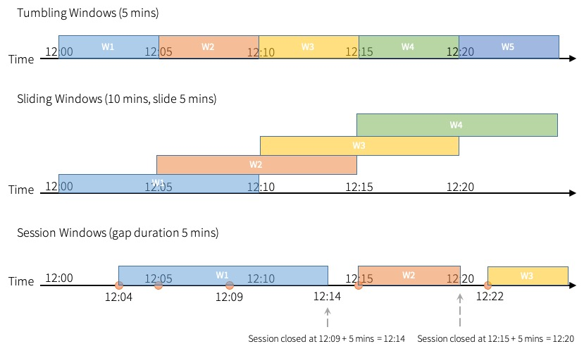
Streaming DataFrames Operations
Supported operations:
Window on event-time
Aggregate values for each window the event-time of a row falls into
Tumbling windows
Sliding windows
Session windows (infrequently used)
Notes:
Sliding Windows
An example would be to compute the moving average of a stock price across the last five minutes, triggered every second or every few seconds.
Tumbling Windows
An example would be to compute the average price of a stock over the last five minutes, computed every five minutes.

Slide 21
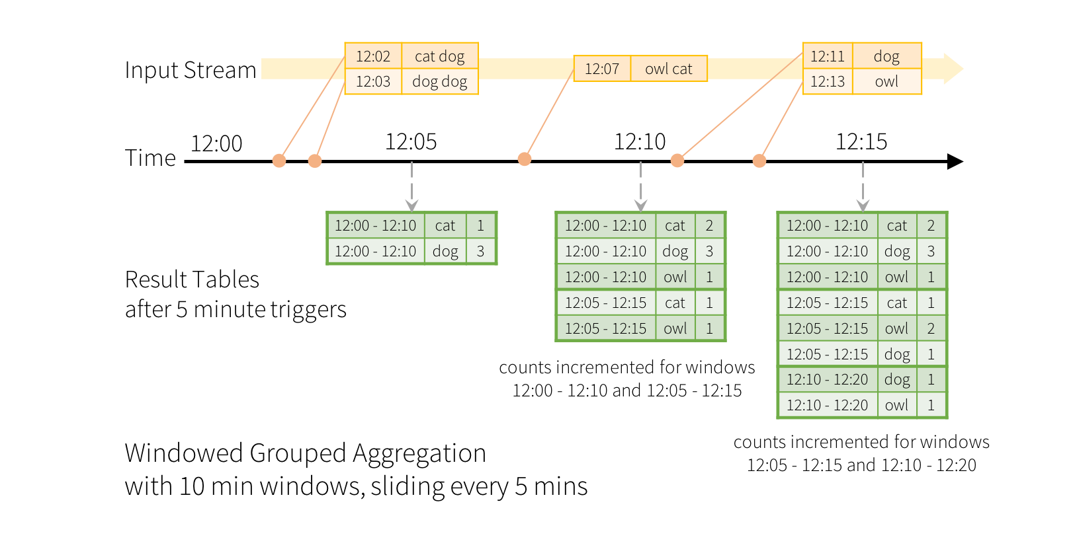
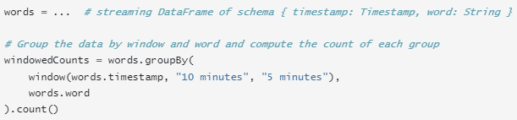
Streaming DataFrames Operations
Supported operations:
Window on event-time
Aggregate values for each window the event-time of a row falls into
Tumbling windows
Sliding windows
Session windows (infrequently used)

Slide 22
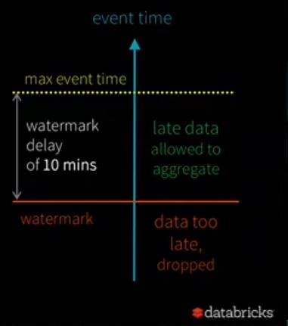
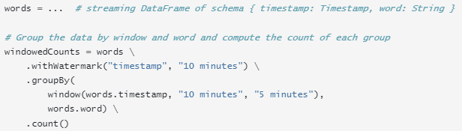
Streaming DataFrames Operations
Supported operations:
Window on event-time
Handle late data using watermarking (soft version)

Slide 23
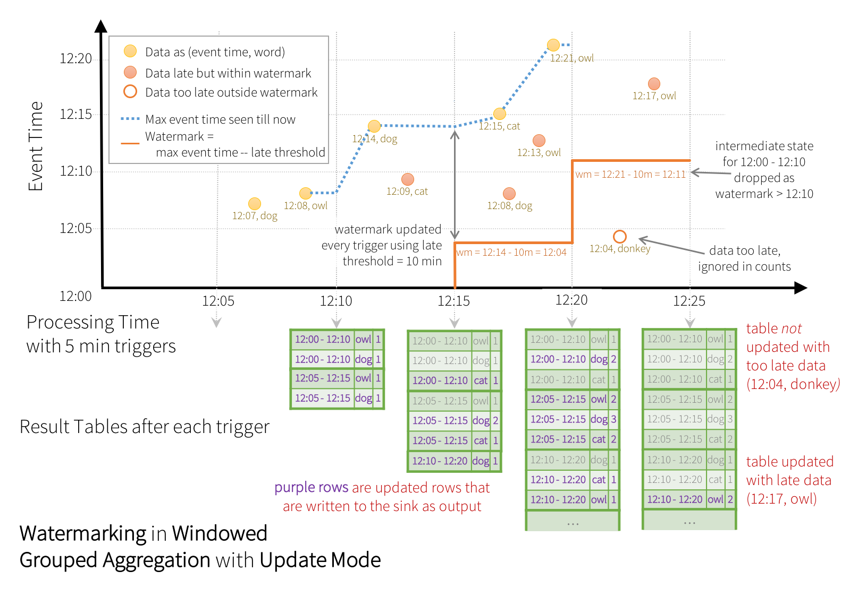
Streaming DataFrames Operations
Supported operations:
Window on event-time
Handle late data using watermarking (hard version)

Slide 24

Streaming DataFrames Operations
Supported operations:
Window on event-time
Watermarking limitations
Output mode must be Append or Update
Aggregation must have either the event-time column, or a window on the event-time column
Method .withWatermark(…) must be called on the same column as the timestamp column used in the aggregate
Method .withWatermark(…) must be called before the aggregation for the watermark details to be used

Slide 25
Streaming DataFrames Operations
Unsupported operations:
Limit and take the first N rows (streaming Datasets)
Distinct operations (streaming Datasets)
Sorting operations are supported only after an aggregation in Complete output mode (streaming Datasets)
Few types of outer joins (streaming Datasets)
…and some others less important ones related to streaming Datasets

Slide 26
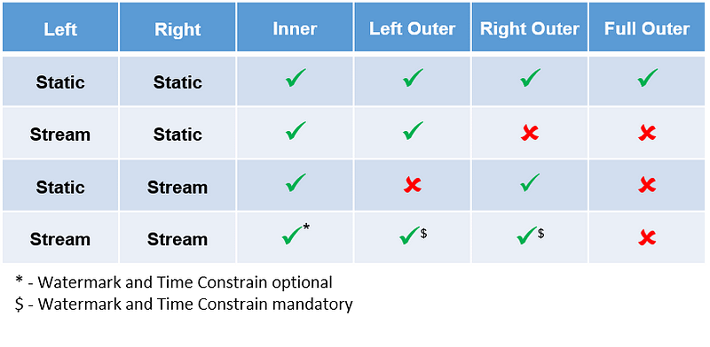
Streaming DataFrames Join operations
Stream-static (or viceversa)
Stream-stream
Notes:
https://dzone.com/articles/spark-structured-streaming-joins

Slide 27
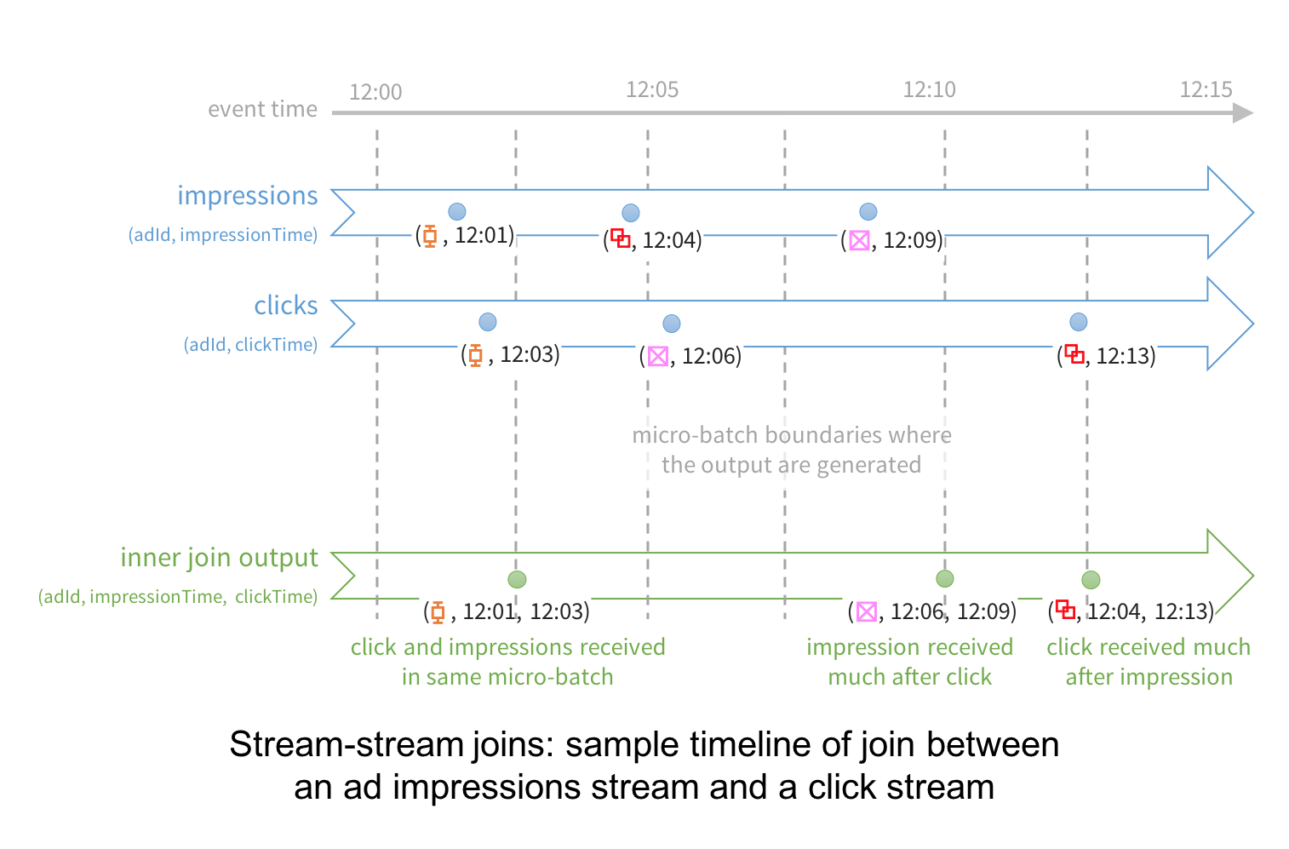
Streaming DataFrames Join operations
Stream-static
Enrich streaming data before sending it to the sink
Stream-stream
Reconcile/Relate independent events
Inner
Outer (left/right)
Notes:
https://dzone.com/articles/spark-structured-streaming-joins

Slide 28
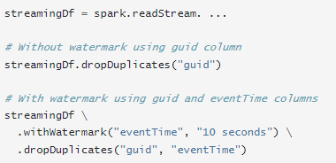
Streaming DataFrames Deduplication
With watermark
Bounded amount of state to maintain
Without watermark
Unbounded amount of state to maintain
Notes:
https://dzone.com/articles/spark-structured-streaming-joins

Slide 29
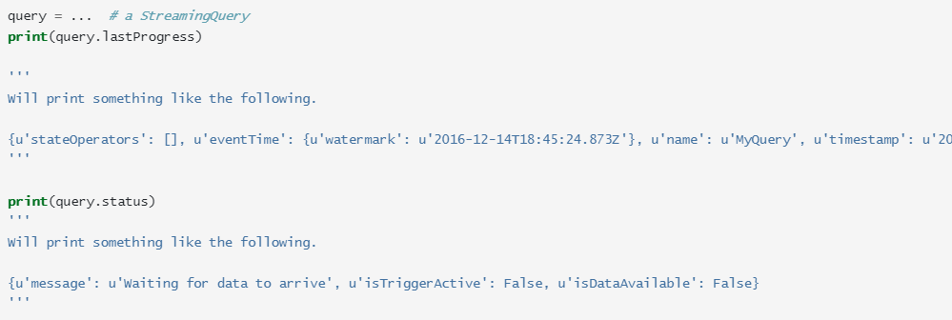
Streaming DataFrames Monitoring queries
Reading metrics interactively

Slide 30
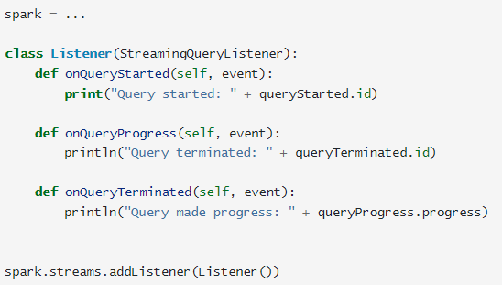
Streaming DataFrames Monitoring queries
Reading metrics programmatically using Async APIs

Slide 31
Hands-on lab
https://github.com/jcarloslr10/structured-streaming

Slide 32
THANK YOU!
Any questions?

Slide 33
STRUCTURED STREAMING
Session 2: Delta Lake for streaming
Juan Carlos López

Slide 34
Agenda
Basics
Table operations and considerations
Change Data Feed
Recommendations using Delta Lake
Hands-on lab using PySpark 3.3.0 y Delta Lake 2.3.0
10:00 - 10:20
10:20 - 10:40
10:40 - 11:15
11:15 - 11:45
11:45 - 13:00

Slide 35
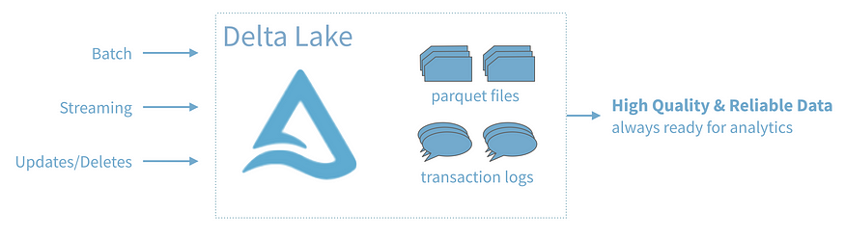
Basics Features
ACID transactions
Scalable metadata handling
Streaming and batch unification
Schema enforcement
Time travel (data versioning)
Upserts and deletes
Additional features and optimizations via Databricks

Slide 36
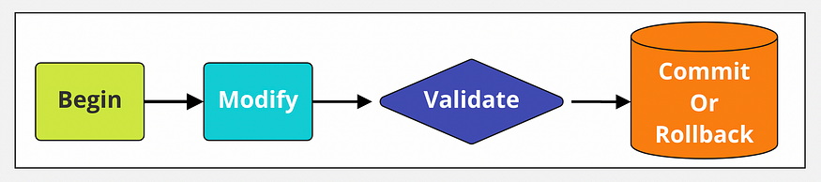
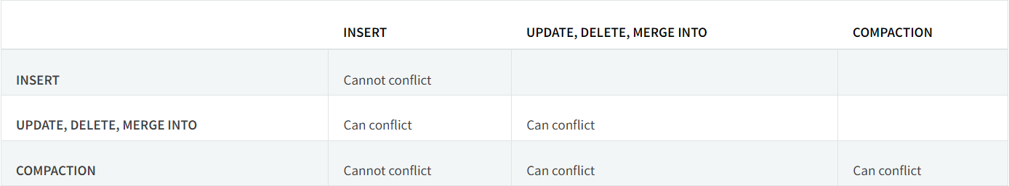
Basics Features
ACID transactions
Optimistic concurrency control
Write conflicts
Avoid conflicts using partitioning and disjoint command conditions

Slide 37
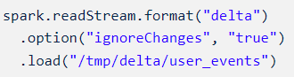
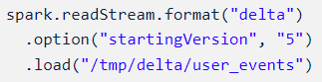
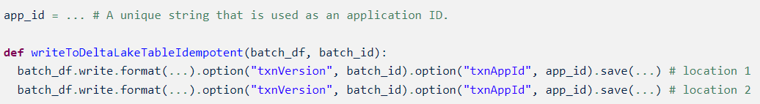
Basics Features
Streaming and batch unification
Delta table as a source
Limit input rate (maxBytesPerTrigger) for control micro-batches
Ignore updates and deletes
Specify initial position
Version or timestamp
Delta table as a sink
Idempotent table writes in foreachBatch

Slide 38
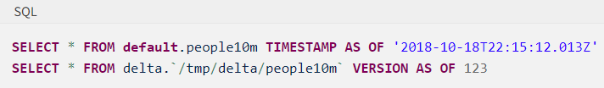
Basics Features
Time travel (data versioning)
Query an older snapshot of a Delta table
Timestamp
Version (DESCRIBE HISTORY command)
Data retention up to 30 days old by default
VACUUM for deleting data files explicitly

Slide 39
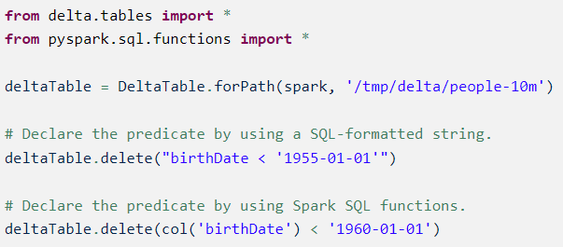
Table operations and considerations Deletes
DELETE/delete removes the data from the latest version (not physically until VACUUM)
Predicates on partition column can significantly speed up the operation (when possible)

Slide 40
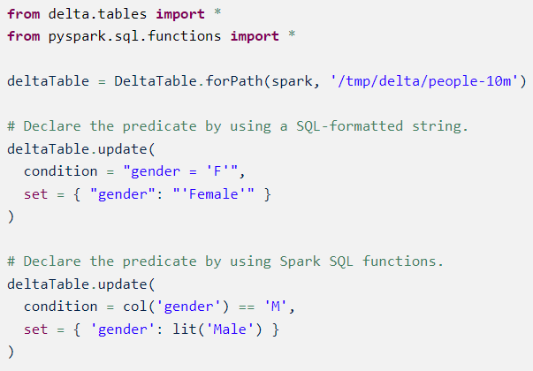
Table operations and considerations Updates
UPDATE/update change data that matches a predicate with new value/s
Predicates on partition column can significantly speed up the operation (when possible)

Slide 41
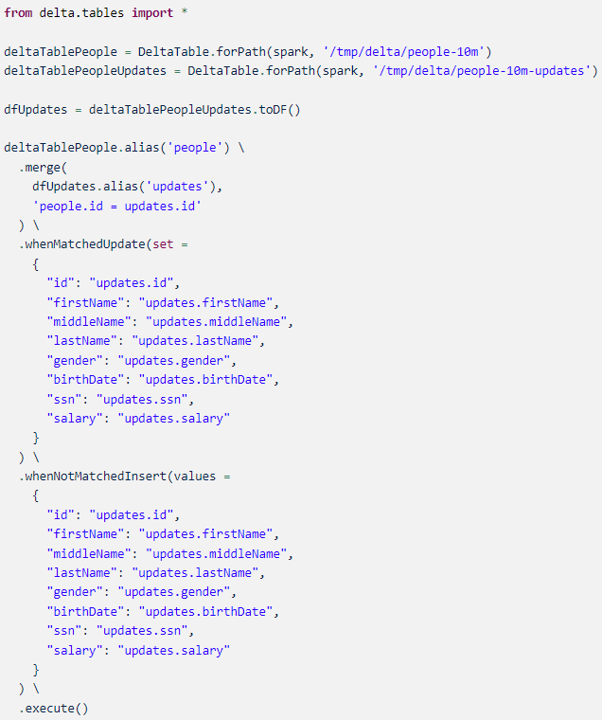
Table operations and considerations Upserts
Insert, update and delete operations using MERGE/merge
Allows complex use cases
Requires two passes over the data
Beware of non-deterministic operations using Delta 2.1 and below

Slide 42
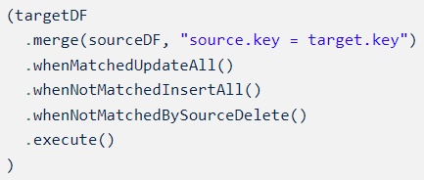
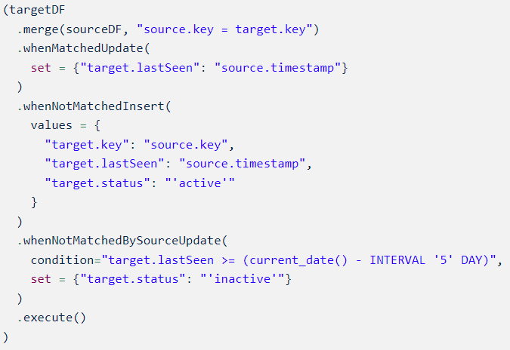
Table operations and considerations Upserts
Modify or delete all unmatched rows using MERGE/merge

Slide 43
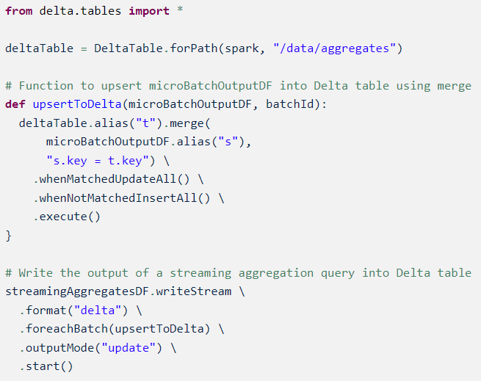
Table operations and considerations Upserts
Write streaming aggregates in Update mode using MERGE/merge
Much more efficient than Complete mode

Slide 44
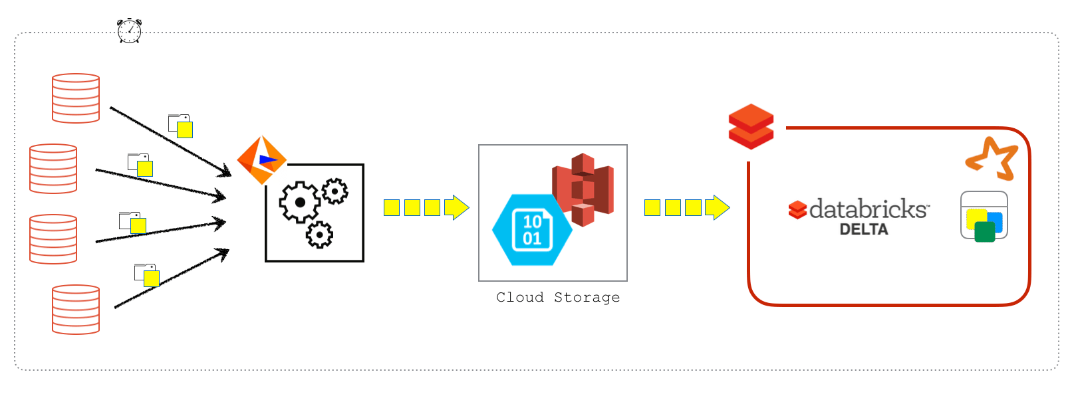
Change Data Feed Prior CDF
CDC with Delta Lake
S3, ADLS Gen2 -> Spark -> Delta Lake
Inneficient to account for non-changing rows
Challenging to execute all this logic

Slide 45
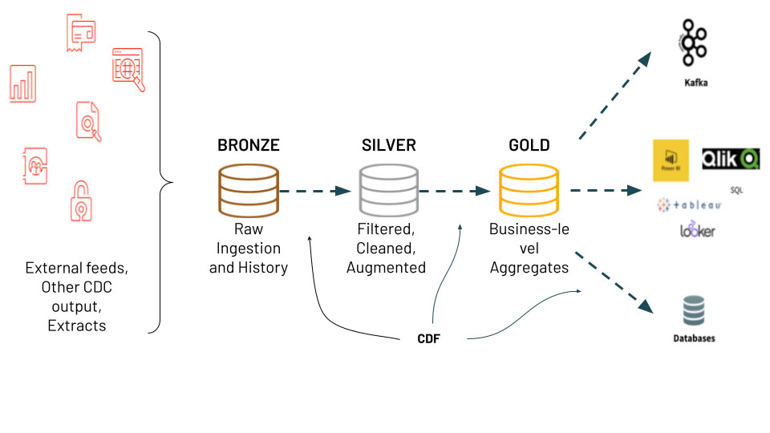
Change Data Feed Features
Simple architecture in comparison with CDC
Enables MERGE operation
Enables log versioning
Not enable by default

Slide 46
Change Data Feed Use cases
Silver and Gold tables
Transmit changes (downstream systems)
Audit trail table

Slide 47
Change Data Feed Enable modes
New table
Existing table
All new tables

Slide 48
Change Data Feed Data
Records change data for operations:
UPDATE
DELETE
MERGE
Retention policy
Same as table
VACUUM affects CDF data

Slide 49
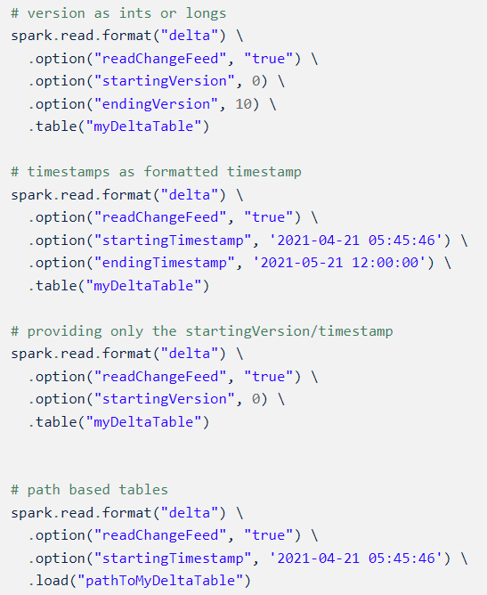
Change Data Feed Reading changes
Batch queries

Slide 50
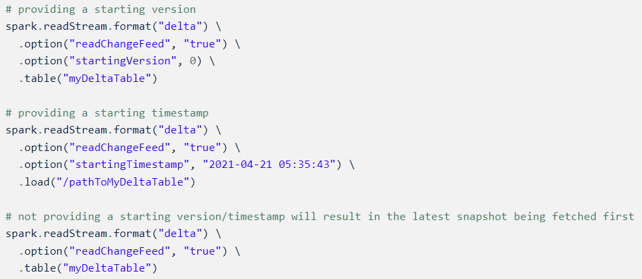
Change Data Feed Reading changes
Streaming queries

Slide 51
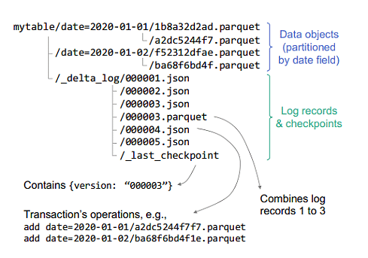
Recommendations using Delta Lake Partitioning
When do not
Do not partition tables that contains less than 1 TB of data (ingestion time clustering)
How (rule of thumb)
Do not use a column with a very high cardinality
Minimum amount of data in each partition (1GB)

Slide 52
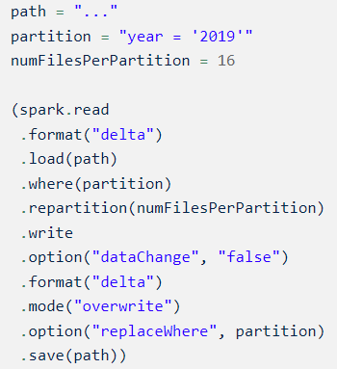
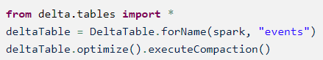
Recommendations using Delta Lake Compaction
Repartition (Spark)
Table
Partition
Optimize (Databricks Delta Lake)

Slide 53
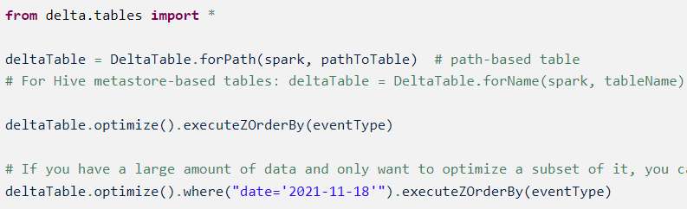
Recommendations using Delta Lake Data skipping & Z-Ordering
Data skipping
Statistics collected automatically
Depends on the layout of the data (z-ordering)
Z-Ordering
Colocate related information in the same set of files
Reduces the amount of data to be read

Slide 54
Recommendations using Delta Lake Data skipping & Z-Ordering
When do
Column has statistics (min, max, count…)
Column commonly used in query predicates
Column with high cardinality
Effectiveness of locality drops with each extra column

Slide 55
Recommendations using Delta Lake Cache
When do not
Do not cache when using additional filters on top of the cached DFs (no data skipping)
Cached DFs might not be updated if table is written later

Slide 56
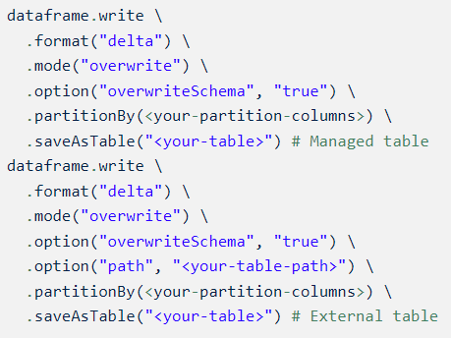
Recommendations using Delta Lake Replace the content or schema of a table
Benefits of overwriting over deleting
Much faster because it does not need to list recursively or delete any files
Old version of the table still exists
Atomic operation while other queries can still read concurrently
ACID guarantees either the new overwrite or previous state

Slide 57
Hands-on lab
https://github.com/jcarloslr10/structured-streaming

Slide 58
THANK YOU!
Any questions?

Slide 59
STRUCTURED STREAMING
Session 3: Config on production env
Juan Carlos López

Slide 60
Agenda
Workload settings
Maintenance tasks
Questions & Answers
10:00 - 10:45
10:45 - 11:30
11:50 - 12:30

Slide 61
Workload settings Batch size configuration
Azure Databricks provides same options for Delta Lake and AutoLoader:
Limit input rate with maxFilesPerTrigger
Delta/AutoLoader 1000 by default
Spark no limit by default
Limit input rate with maxBytesPerTrigger
Configuring 10GB and files are 3GB → Databricks processes 12GB (Soft max)
There is no default
When using both, the micro-batch processes data until reaching the lower limit
Azure Databricks for Kafka
Limit input rate with maxOffsetsPerTrigger

Slide 62
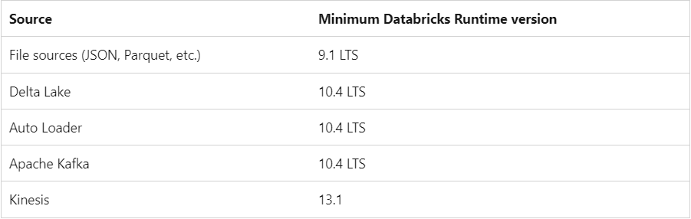
Workload settings Trigger interval configuration
Time-based trigger
Balance between latency and data rate
500ms by default
Avoid performing unnecessary checks (99% time not less than 10s) or processing undersized batches
Incremental batch processing using Trigger.AvailableNow
Limit input rate with maxBytesPerTrigger

Slide 63
Workload settings Recommendations for stateful queries
Use compute-optimized instances as workers (Standard_F16s instances)
Set the number of shuffle partitions to 1-2 times number of cores in the cluster
Set spark.sql.streaming.noDataMicroBatches.enabled to false in the SparkSession
Use watermarking to reduce the total amount of state information to be processed
Keep the interval of the watermark as small as possible

Slide 64
Workload settings Recommendations for state store
Default state management can maintain up to 1-2 million state keys/executor
RocksDB-based state management can maintain up to 100 million state keys/executor
Beyond the above numbers, JVM GC starts to affect performance significantly

Slide 65
Workload settings Recommendations for recovering from failures
Always specify the checkpointLocation option
Multiple queries should never have the same checkpoint location

Slide 66
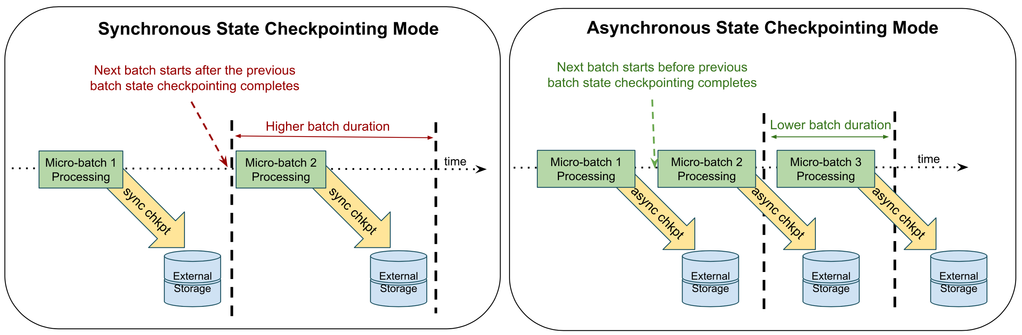
Workload settings Recommendations for checkpointing
Enable asynchronous state checkpointing can reduce end-to-end latencies
Higher restart delays
Idempotent process needed

Slide 67
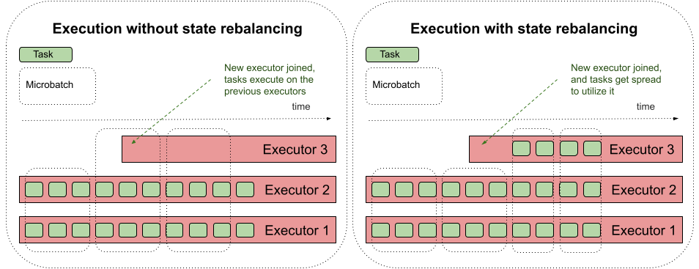
Workload settings Recommendations for state rebalancing
Increase cluster utilization and reduce micro-batch latency
Scaling/Autoscaling needed

Slide 68
Workload settings Recommendations for monitoring
Use .queryName(…) method in the writeStream code to identify the query
Use Streaming Query Listeners to send metrics to external systems (Azure Log Analytics Workspace, Kafka…)
Minimize logic and latency in these listeners to not impact query processing

Slide 69

Workload settings Recommendations using AutoLoader
Monitoring listen to stream updates using Streaming Query Listener
Run AutoLoader in batch mode instead of running continuously
Using Trigger.AvailableNow
To save costs due to file discovery
Architecting file uploads to storage in lexical ordering to leverage Incremental Listing when possible
Use Databricks Runtime 9.0 or later in directory listing mode, especially for deeply nested directories

Slide 70
Workload settings Recommendations using MERGE
Reduce the search space for matches
Compact files
Control the shuffle partitions for writes
spark.sql.shuffle.partitions
Balance between parallelism and larger number of smaller data files
Repartition output data before write
spark.databricks.delta.merge.repartitionBeforeWrite.enabled
Every shuffle task can write multiple files in multiple partitions generating a bottleneck

Slide 71
Workload settings How to measure
Testing
Load, stress and soak testing
Automate process for data ingestion at the source (either events or files)
Setup cluster and streams to track and send metrics to external system (Azure Log Analytics, Datadog…)
Collect and analyze the data sent to the external system to detect and understand the limits of your platform (there is no magic formula)
Act accordingly (increasing/decreasing resources)

Slide 72



Maintenance tasks Compaction
Improve the speed of read queries coalescing small files
Managed table
Unmanaged table
Table partition

Slide 73
Maintenance tasks Compaction
Idempotent process
Produce evenly-balanced data files with respect to their size
Allows read queries concurrently with no interruption

Slide 74
Maintenance tasks Compaction
Run frequency
Daily basis (at night if possible)
Adjust to balance cost and performance trade-offs
Best instance type
Compute optimized instances
CPU intensive process

Slide 75

Maintenance tasks Auto-compaction
Like OPTIMIZE but within Delta table partitions
Table level
Session level
Syncronously after a write to table
Triggered when reaching at least a certain number of files

Slide 76

Maintenance tasks Vacuum
Run frequency
Daily basis (at night if possible)
Adjust to balance cost and performance trade-offs
Benefits
Reduce storage costs
Compliance reasons

Slide 77
Maintenance tasks Vacuum
Cluster size needed
Slowdown on identifying files to be removed → Increase number of worker nodes
Slowdown on delete commands → Increase size of driver

Slide 78
Maintenance tasks How to run
Azure Data Factory pipeline
Allows orchestration
Stop streaming jobs (when needed)
Run maintenance tasks
Run streaming jobs (when needed)

Slide 79
Q & A

Slide 80
THANK YOU!
Any questions?

